Slide 1

SuperBigBite DAQ update
Bryan Moffit
Jefferson Lab
SBS DOE Review – November 2015

Slide 2
Outline
SBS requirements
Fastbus Readout
FADC HCAL readout
GEM readout
Timeline
Manpower

Slide 3
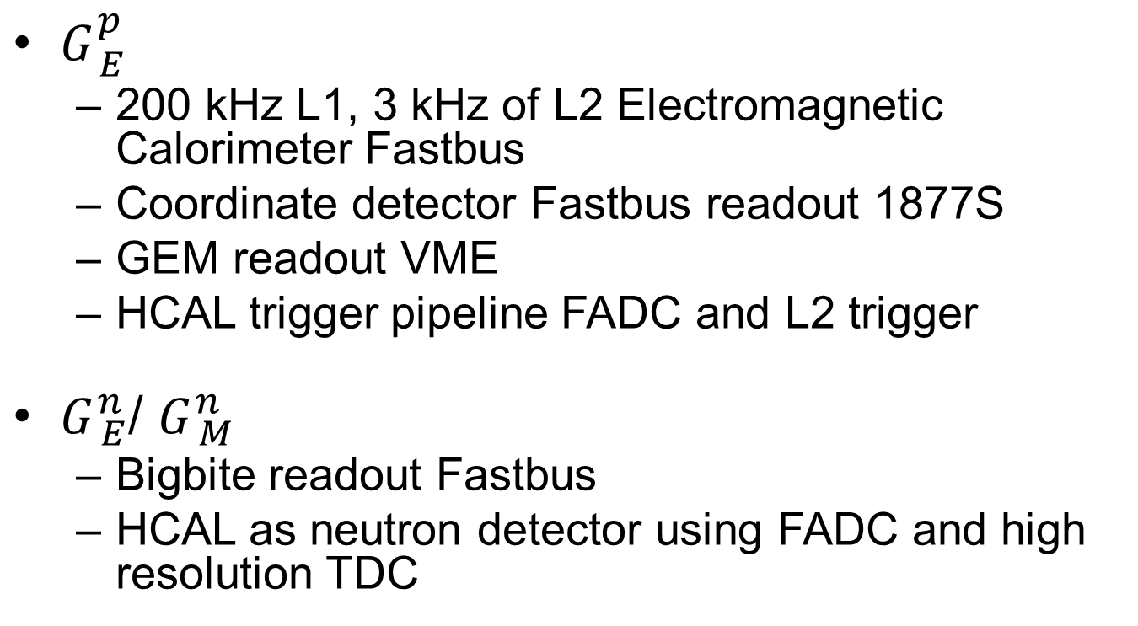
SBS DAQ requirements
$G_{ E}^{p}$
200 kHz L1, 3 kHz of L2 Electromagnetic Calorimeter Fastbus
Coordinate detector Fastbus readout 1877S
GEM readout VME
HCAL trigger pipeline FADC and L2 trigger
$G_{ E}^{n}$/ $G_{ M}^{n}$
Bigbite readout Fastbus
HCAL as neutron detector using FADC and high resolution TDC

Slide 4
Fastbus update
Use new CODA 3.0 TI and TS
More flexibility in programming
Event blocking
Absolute timestamp for synchronization check
Trigger partitioning capability only use a subset of modules
Asked for modified firmware to DAQ group in May 2015 ( William Gu and Bryan Moffit )
Firmware being developed and tested

Slide 5
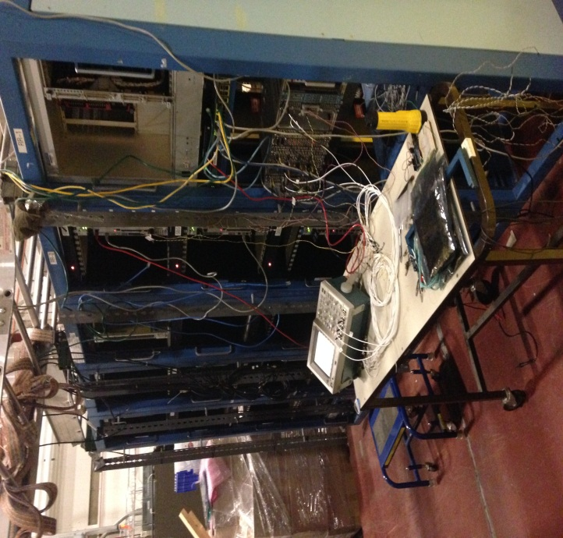
Fastbus update
Have sufficient TDCs, ADCs, crates, aux. cards
Like to scrounge ~3 more SFI (Struck Fastbus Interface)
(backup plan: fewer crates, reduced performance)
Making FB faster
sparsification – works
event blocking – works
event switching – being tested
merging with pipelining VME – to be tried
Three large Fastbus systems assembled in the test lab.
have 236
need 124
have 113
need 94
have 30
need 21

Slide 6
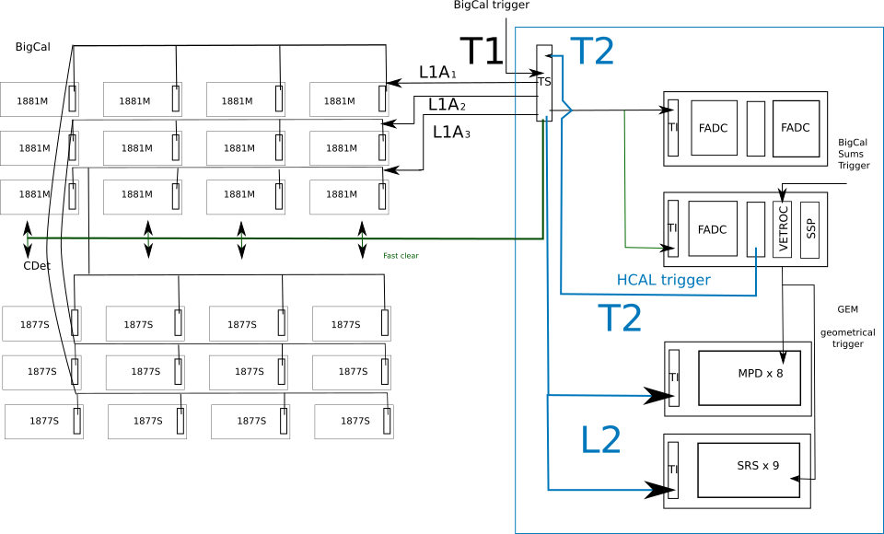

$G_{ E}^{p}$ DAQ Configuration / both arms
Fastbus
L2
L2
L2
T2 distributed to Hadron and Electron Arms;
if no L2A, Fast Clear to Fastbus

Slide 7
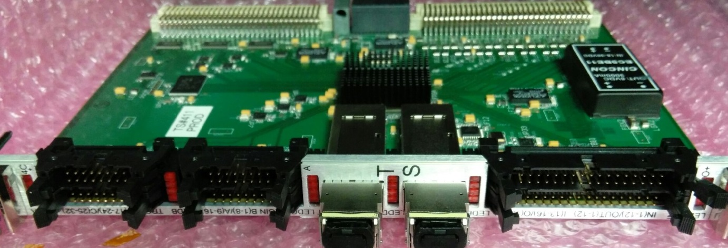
HallA SBS Trigger block diagram
VME reg. 0x6C
Program table
Local Trigger
Lookup table
32x1
Trigger Rule
L5/6, BIP#1
Local TRG#1
Width
R17/18, TRG#1
L7/8, BIP#2
Local TRG#2
Width
R19/20, TRG#2
L9/10, BIP#3
Local Trigger
distribution
Local TRG#3
Width
R21/22, TRG#3
L11/12, BIP#4
Local TRG#4
Width
R23/24, TRG#4
UL1/2, TRG#1
Delay
Match
FastClear#1
Width
R5/6, FastCl#1
UL3/4, TRG#2
Delay
Match
R7/8, FastCl#2
UL5/6, TRG#3
FastClear#2
Width
UL7/8, TRG#4
VME 0x28
Bit(16:12)
DAQ# enable
Delay
Match
FastClear#3
Width
R9/10, FastCl#3
UL9/10, TRG#5
Delay
Match
FastClear#4
R11/12, FastCl#4
NO
Width
LL1/2, #1
ReadOut Trigger
Delay, Prescale,
Lookup table,
Trigger Rule
Trigger
Width Ext
YES
LL15/16, #8
Delay/Width
LR1/2, #9
Trigger
word
second
word
Serializer
VXS P0, TRG
LR15/16, #16
Serializer/Fiber
QSF#A, to TI
VME P2 GTP
#1 --- #32
Prompt Trigger
Serializer/Fiber
QSF#B, to TI
VME P1
VXS P0
VME P2
UL
UR
LL
LR
QSFA
QSFB
L
R

Slide 8
Pedestal Suppression
Local trigger ~ 50 kHz
Local trigger ~ 100 kHz
Local trigger ~ 200 kHz
No Pedestal
Suppression (8ADCs)
Single Crate
8 ADCs
Buffer level = 4
Dead time at
Local ~ 200 kHz and Readout ~5kHz
D₁ ~40%
Pedestal
Suppressed
Expected ~ 5000 Hz

Slide 9
Trigger Switching
No Pedestal
Suppression (8ADCs)
Local trigger ~ 50 kHz
Local trigger ~ 100 kHz
Local trigger ~ 200 kHz
Dead time at
Local ~ 200 kHz and Readout ~5kHz
D₃ ~6%
Pedestal
Suppressed
D₃ ~ (D₁)³
Expected ~ 5000 Hz

Slide 10
Trigger Switching – near 5 kHz
No pedestal suppression (8ADC)
Readout trigger rate ~ 5kHz
1 crates
2 crates
3 crates

Slide 11
HCAL
All FADC 16 delivered
2 VXS crates delivered
2 Intel Concurrent CPU delivered
Readout tested
Development of trigger using HPS firmware and GTP
New VTP ordered

Slide 12
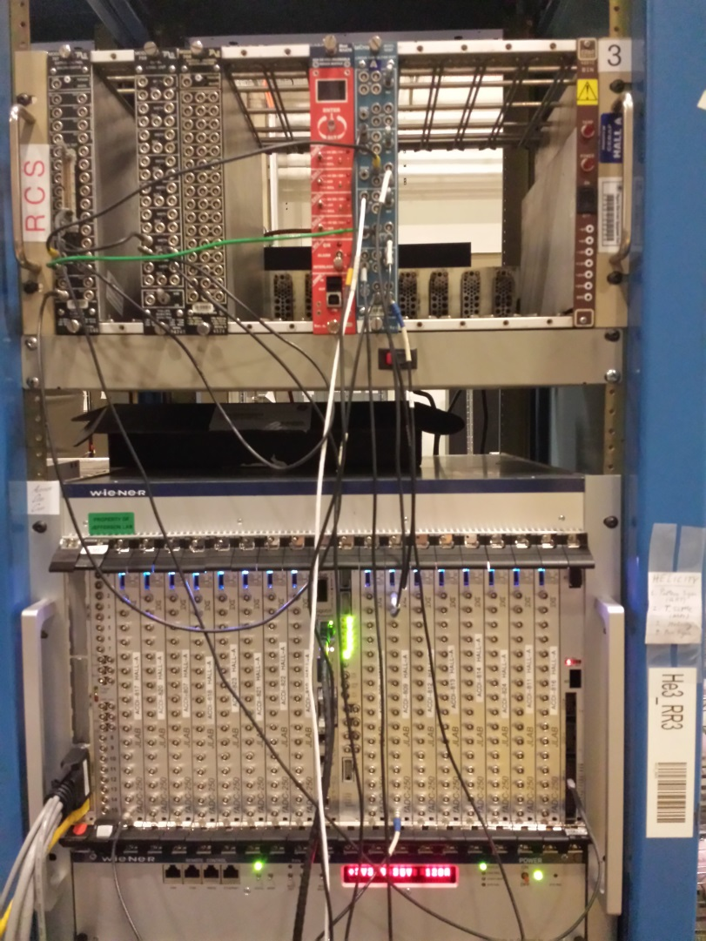
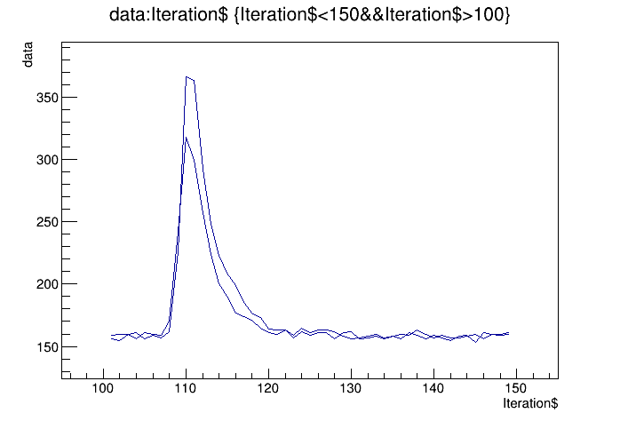
HCAL FADC electronics
Cosmics from calorimeter block
Will test later with HCAL module

Slide 13
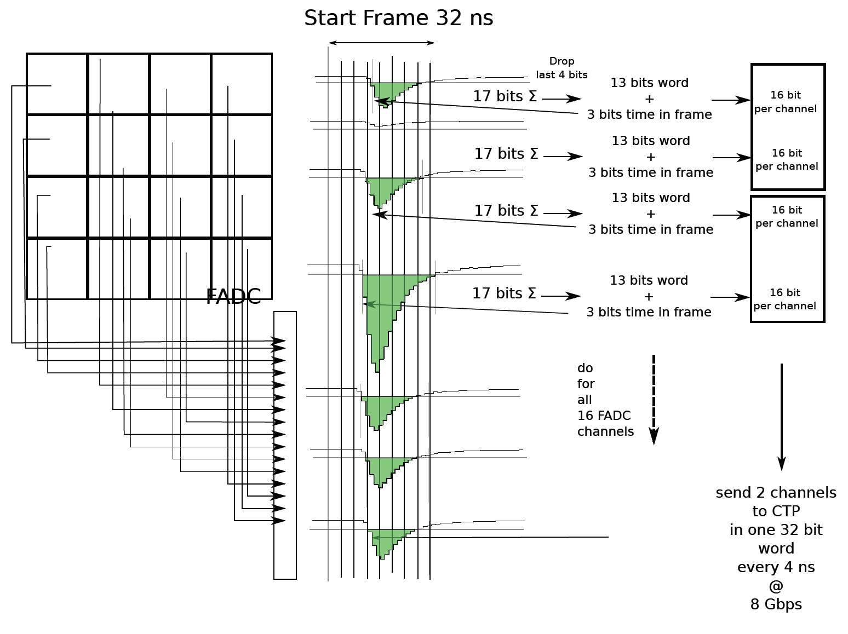
Hadron Arm - HCAL DAQ: proton trigger
HCal Signals to FADC inputs
2 VME switched Serial (VXS) Crates
JLAB FADC250, a 16-channel 12-bit FADC sampling at 250 MHz
16 FADC in VXS Crate 1
2 FADC in VXS Crate 2
If signal pass threshold
Integrates signal and subtracts pedestal
Sends time frame info
VTP (Crate Trigger Processor)
Located in VXS crates
Collects integrated signal and timing from FADC channels
Sends data to the second VTP for clustering

Slide 14
HCAL trigger development
HPS firmware installed on FADC and GTP
FADC readout tested with cosmics
Testing triggering capability
Need
implement decoder for analysis
Test using 2 crates and new VTP

Slide 15
GEM MPD readout
INFN MPD used for several years using custom C++ package
Package ported to intel CPU
New C library written for easy integration into CODA
( Bryan Moffit, Evaristo Cisbani, Danning Di )
CODA configuration running
Debugging module initialization

Slide 16
Status MPD
VME part works
Data structure looks fine but data from APV has unexpected small dispersion
Maybe issue with APV configuration (I2C timing)
being investigated

Slide 17
GEM optical link readout
Aurora protocol based
Implemented by Paolo Musico. To be tested.
2 Gbit optical link
250 MB/s per link
Readout up to 32 MPD in parallel
8 GB/s bandwidth compared to ~100 MB/s using VME
SSP library
Readout routines – Completed.
MPD configuration routines – In progress
Link from MPD to SSP module
Implemented by Ben Raydo. Works.

Slide 18
Timeline
4th quarter 2015 | 1st quarter 2016 | 2st quarter 2016 | 3rd quarter 2016
Finish MPD CODA readout - debug Finish Fastbus Readout – debug Small scale setup Test 200 KHz L1 and 5 kHz coinc with Fastbus, MPD, and HCAL FADC Cdet Fastbus Analysis software : check synchronization Test MPD optical readout HCAL trigger ordered | Implement new HCAL Trigger module HCAL cosmics GEM cosmics with MPD Test GEM readout with optical link in high background at UVA Develop GEM analysis software | GEM installed on BigBite for tritium experiment ECal cosmics Parasitic test during DVCS : Fastbus and FADC setup | Tritium experiment Parasitic test during Tritium : Fastbus and FADC setup

Slide 19
Manpower
Fastbus
JLAB : Dasuni Adikaram, Mark Jones, Robert Michaels, Bryan Moffit, William Gu
MPD
INFN : Evaristo Cisbani, Paolo Musico
UVA : Danning Di, Kondo Gnanvo, Nilanga Liyanage
JLAB : Ben Raydo, Bryan Moffit
Stony Brook : Seamus Riordan
HCAL
JLAB : Alexandre Camsonne, Ben Raydo, Bryan Moffit

Slide 20
Conclusion
Fastbus flipping module close to be complete
Preliminary results show acceptable dead time in experiment conditions
Need to develop software and check synchronization
HCAL:
FADC ready
trigger implemented and being tested
MPD:
CODA readout implemented
Debugging of the software driver
Optical readout in progress
Small scale test setup in a few weeks

